Slide 1

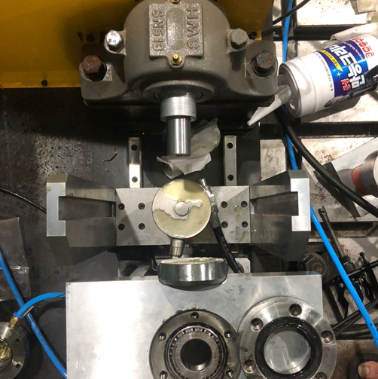
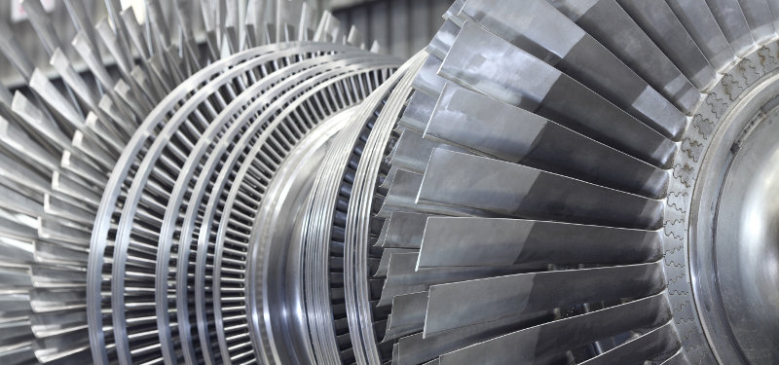

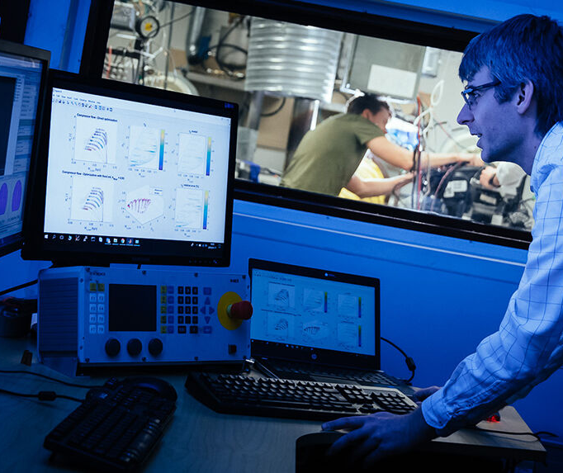

Enhanced Bearing Fault Diagnosis Using Statistical Time Features and Independent Component Analysis: A Comparative Study of Neural and Non-Neural Models
Faisal Saleem¹, Muhammad Umar¹, Wasim Zaman¹ and Jong-Myon Kim^{1,∗}
¹School of Electrical, Electronics, and Computer Engineering, University of Ulsan, Ulsan 44610, South Korea
²PD Technology, Ulsan 44610, South Korea
∗Corresponding author jmkim07@ulsan.ac.kr
1

Slide 2
Presentation Outline
Motivation
Research Problem and Objectives
Proposed Method
Main Contributions
Technical Terms
Experimental Setup and Dataset Description
Results and Performance Evaluation
Conclusions
Future Work Recommendation
2

Slide 3

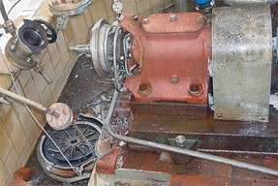
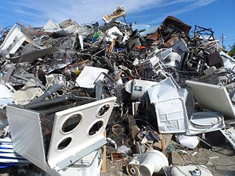
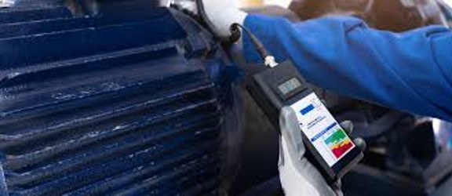







Motivation
Bearings are essential components in machinery, ensuring smooth and efficient operation. However, they contribute to over 51% of motor failures, leading to significant costs and downtime [1].
Equipment breakdown
Waste of resources
and money
Increase downtime
Risk to worker safety
Efficient fault diagnosis ensures sustainability, cost savings, and safety in industrial operations.
[1] Maliuk AS, Prosvirin AE, Ahmad Z, et al (2021) Novel Bearing Fault Diagnosis Using Gaussian Mixture Model-Based Fault Band Selection. Sensors 21:6579. https://doi.org/10.3390/s21196579
3

Slide 4
Research Problem and Objectives
Research Problem
Challenges in Fault Diagnosis
Bearing vibrations are non-stationary and complex, making fault detection difficult.
Large feature sets can distort patterns, leading to inaccurate classifications.
Existing methods often fail due to redundancy and noise in the data.
Objective
Develop a precise and efficient fault diagnosis system for bearings.
Reduce feature complexity using Independent Component Analysis.
Identify and train optimal classifiers for accurate fault detection.
Improve reliability and reduce downtime for industrial machinery.
4

Slide 5
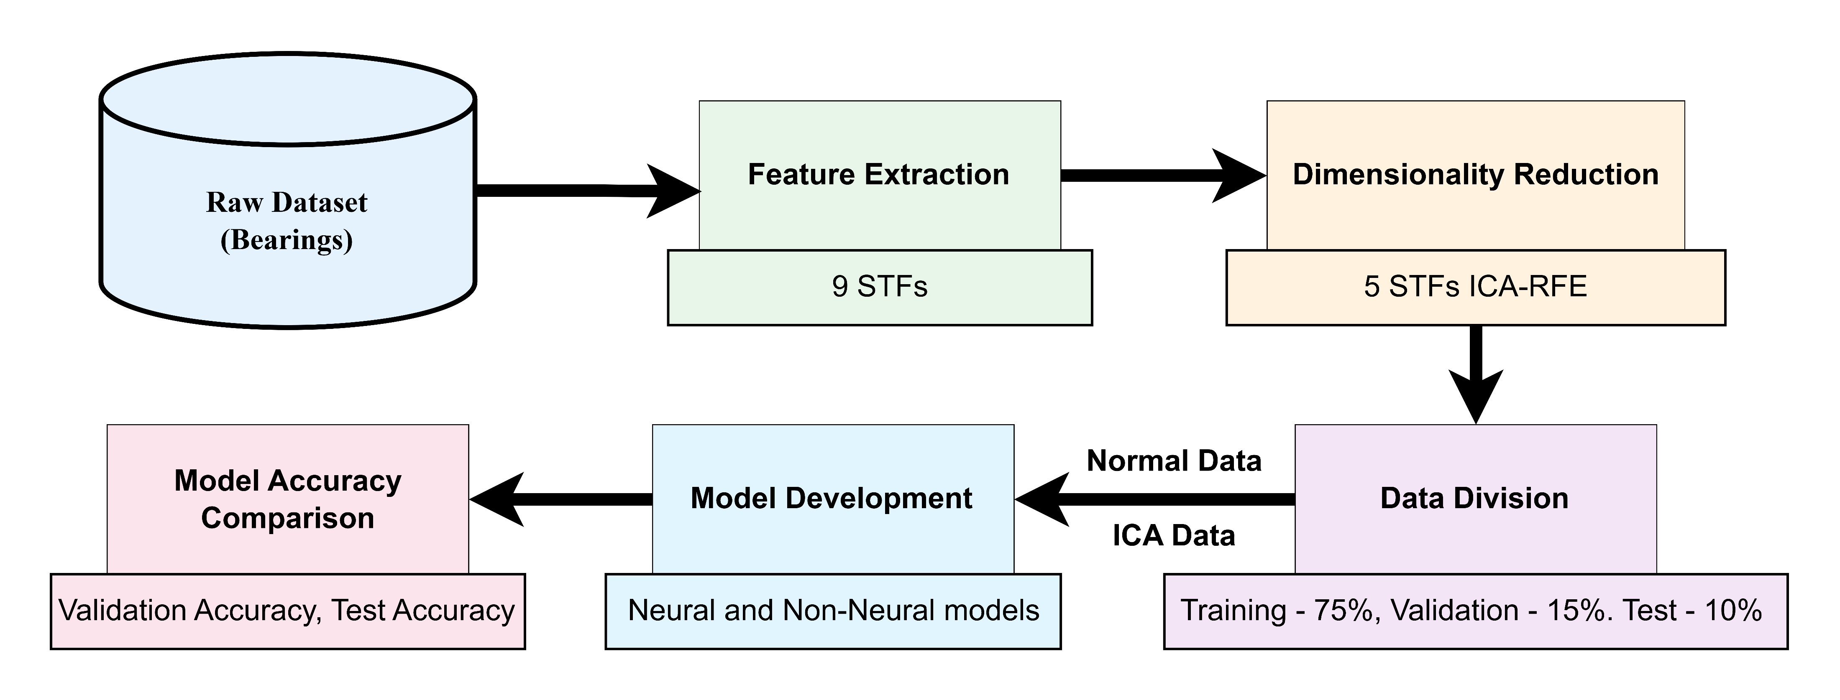
Proposed Method
Figure 1. Flowchart of the proposed method
5

Slide 6
Proposed Method
Dataset Preparation: Collected vibration signals from bearings under four conditions (Inner Race Fault (IRF), Outer Race Fault (ORF), Roller Defect, and Normal).
Feature Extraction: Extracted nine statistical time-domain features (STFs) (e.g., mean, kurtosis, skewness) to represent bearing health and failure.
Feature Engineering: Applied Independent Component Analysis (ICA) and Recursive Feature Elimination (RFE) to reduce the feature set to five more useful features, ensuring relevance, minimizing complexity, and enhancing model performance.
Model Development: Trained neural and non-neural classifiers (e.g., Random Forest, SVM, Neural Networks) on both the original nine features and the reduced five features.
Evaluation: Compared model performance using accuracy and confusion matrices.
6

Slide 7
Main Contribution
Novel Feature Selection
Combined Statistical Time Features with Independent Component Analysis for Better Fault Diagnosis.
Improved Interpretability
Used Recursive Feature Elimination with Random Forest to retain key features and reduce complexity.
Validation with Real-World Data
Tested the approach on real bearing vibration data, proving its reliability and effectiveness.
7

Slide 8
Technical Terms
Statistical Time Features: Important vibration patterns like mean, kurtosis, and skewness used to detect and classify bearing faults. Help capture critical information about machinery conditions.
Table 1. 9 Statistical Time Features
STF | Description
F1 | Mean
F2 | Maximum Value
F3 | Minimum Value
F4 | Root Mean Square
F5 | Kurtosis
F6 | Skewness
F7 | Standard Deviation
F8 | Form Factor
F9 | Crest Factor
Table 2. 5 Important Statistical Time Features
STF | Description
F1 | Mean
F2 | Maximum Value
F3 | Minimum Value
F5 | Kurtosis
F6 | Skewness
Independent Component Analysis: A dimensionality reduction technique to isolate and emphasize unique fault characteristics in data. Simplifies complex feature sets, making models more efficient.
Recursive Feature Elimination: An optimization method to select the most relevant features for fault diagnosis. Reduces redundancy and noise in the dataset.
8

Slide 9
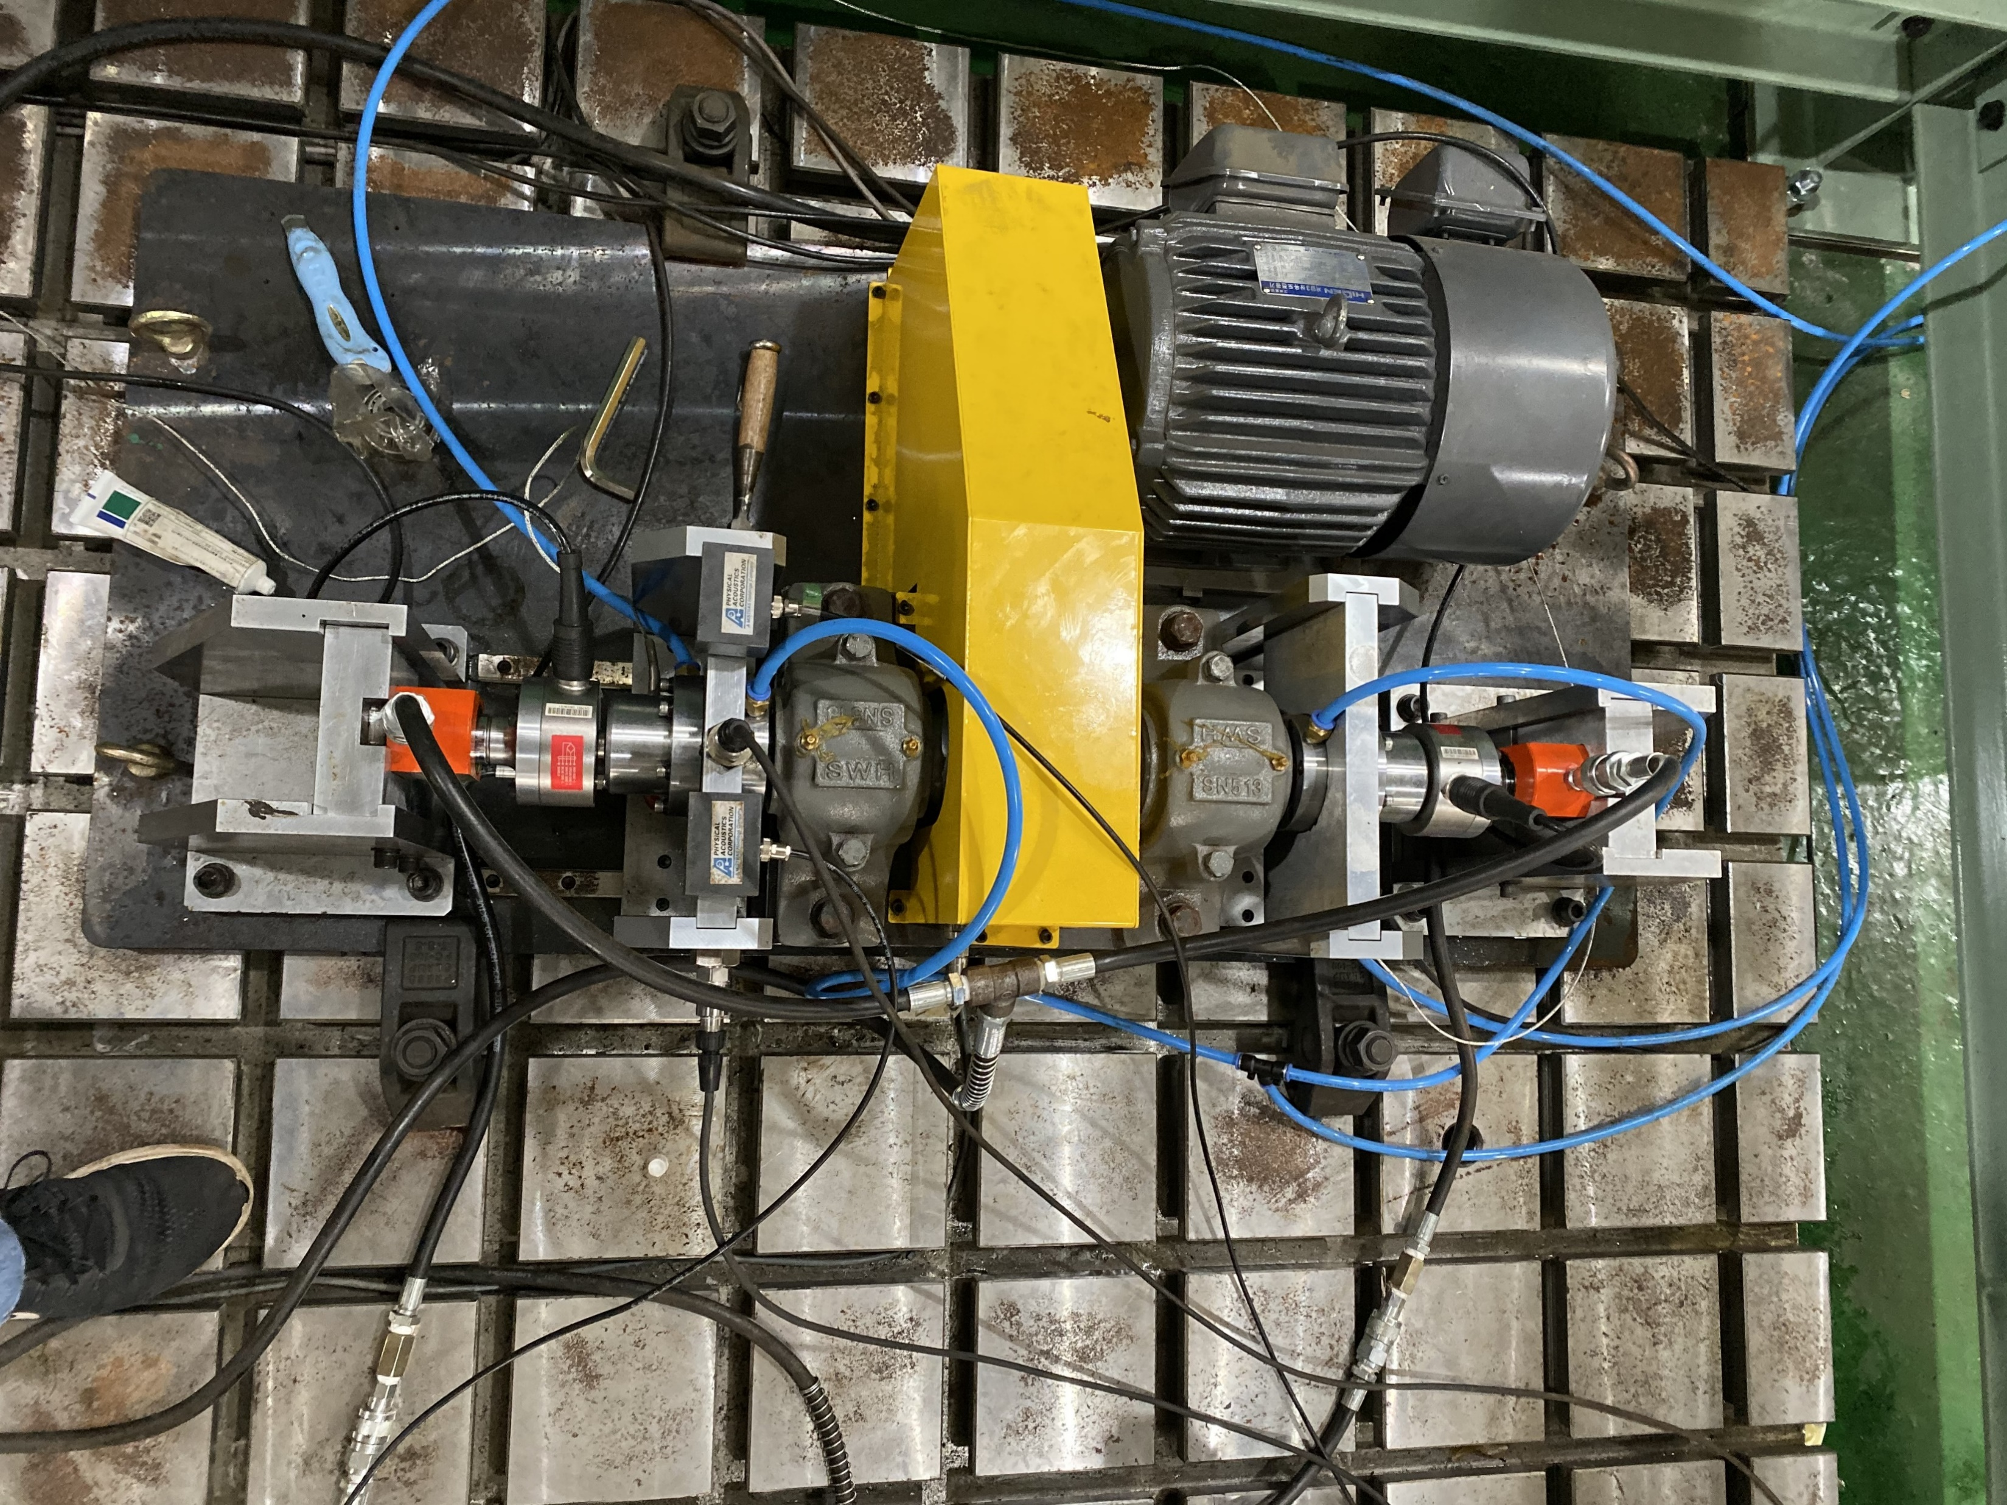

Experimental Setup and Dataset Description
Motor
Axial load
Radial load
Axial load
Target bearing housing
9

Slide 10
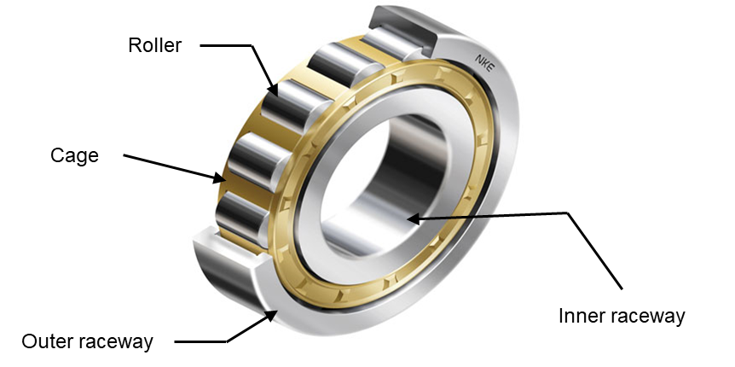
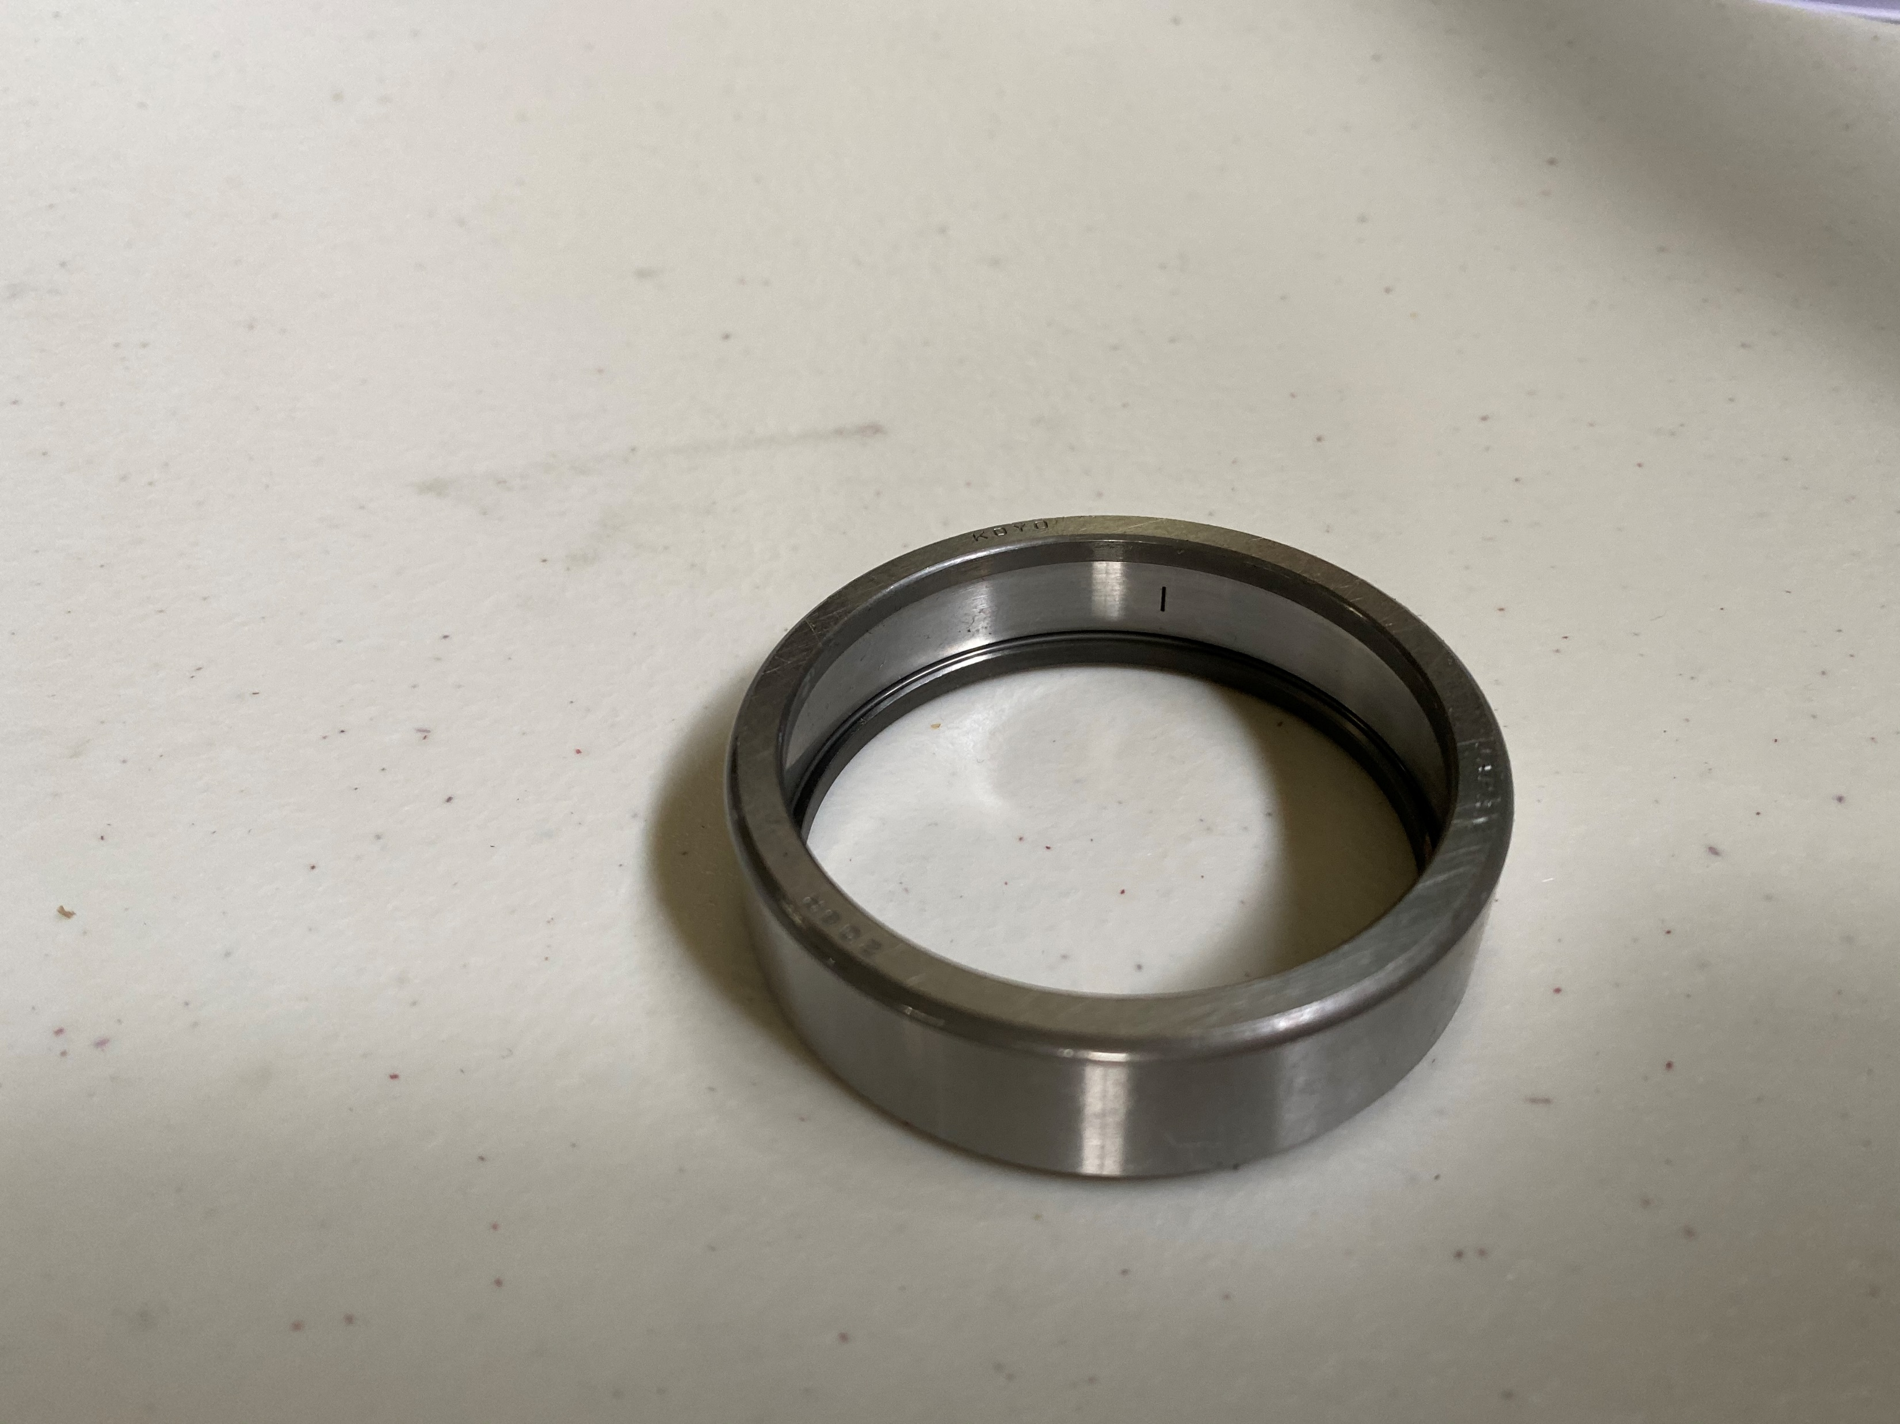
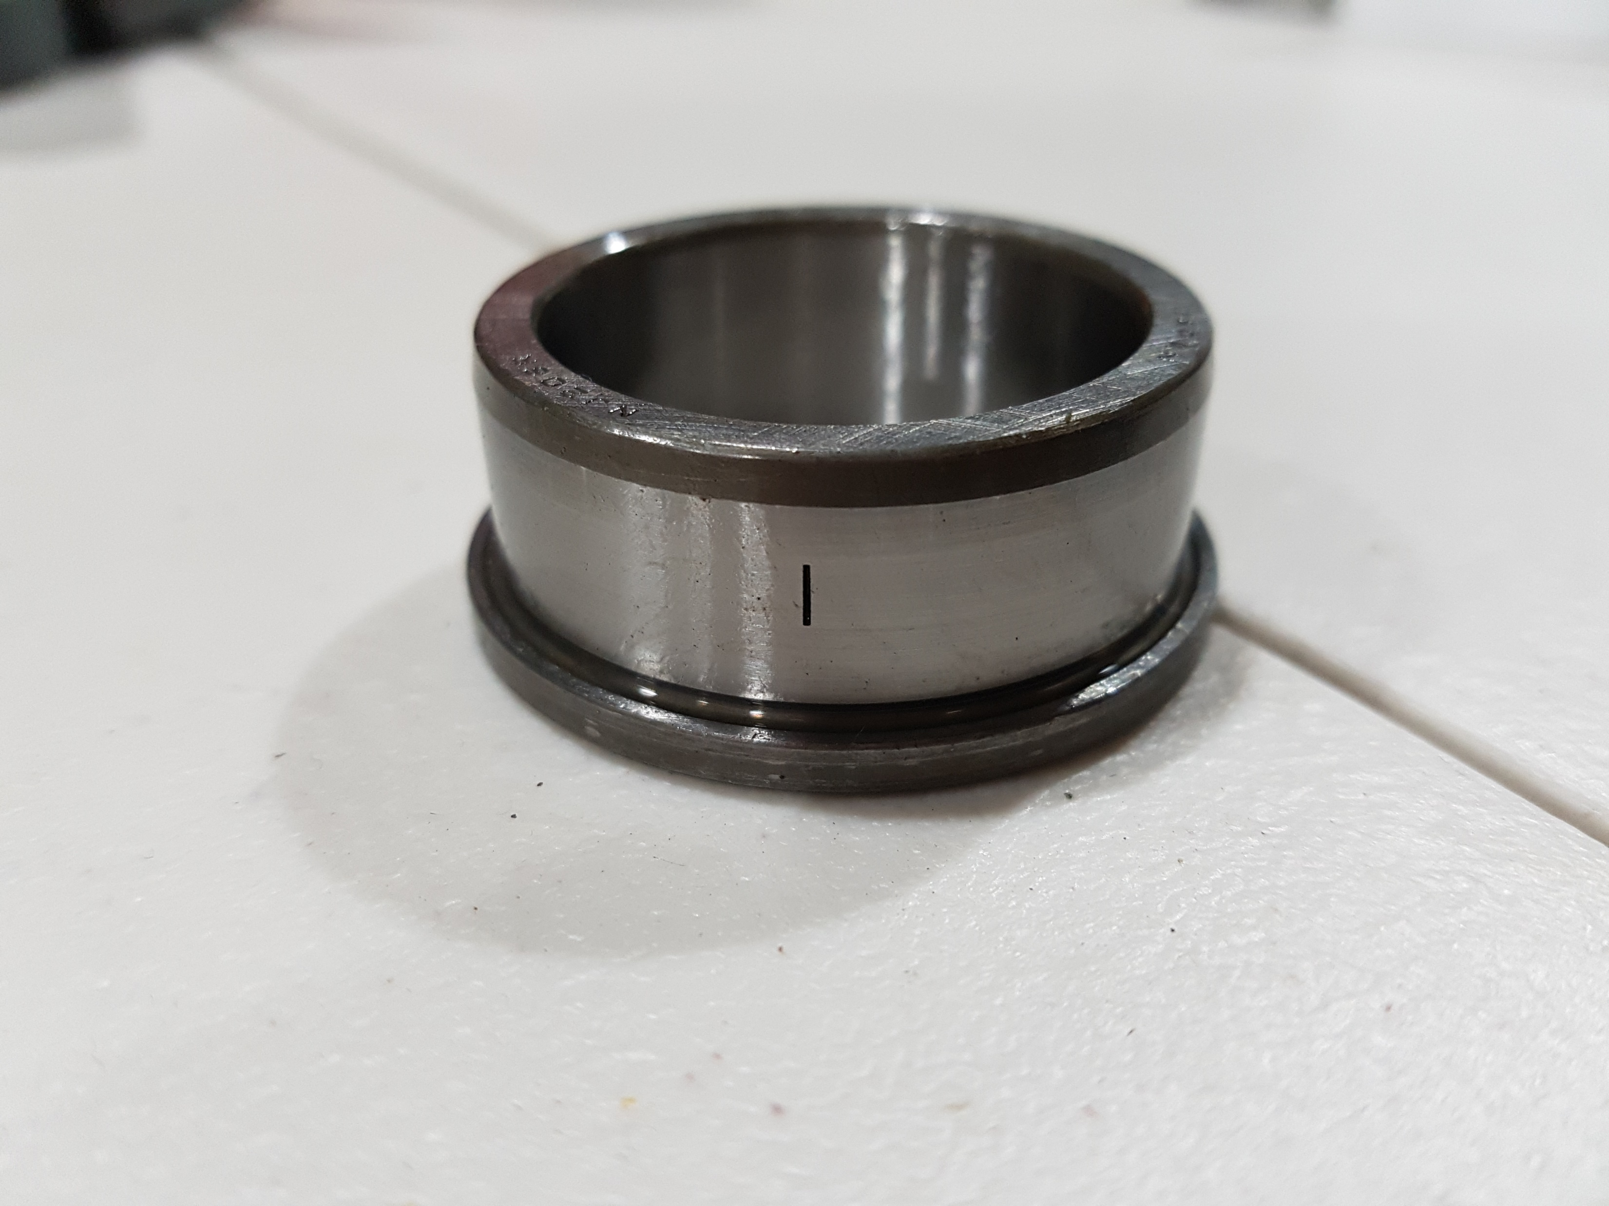
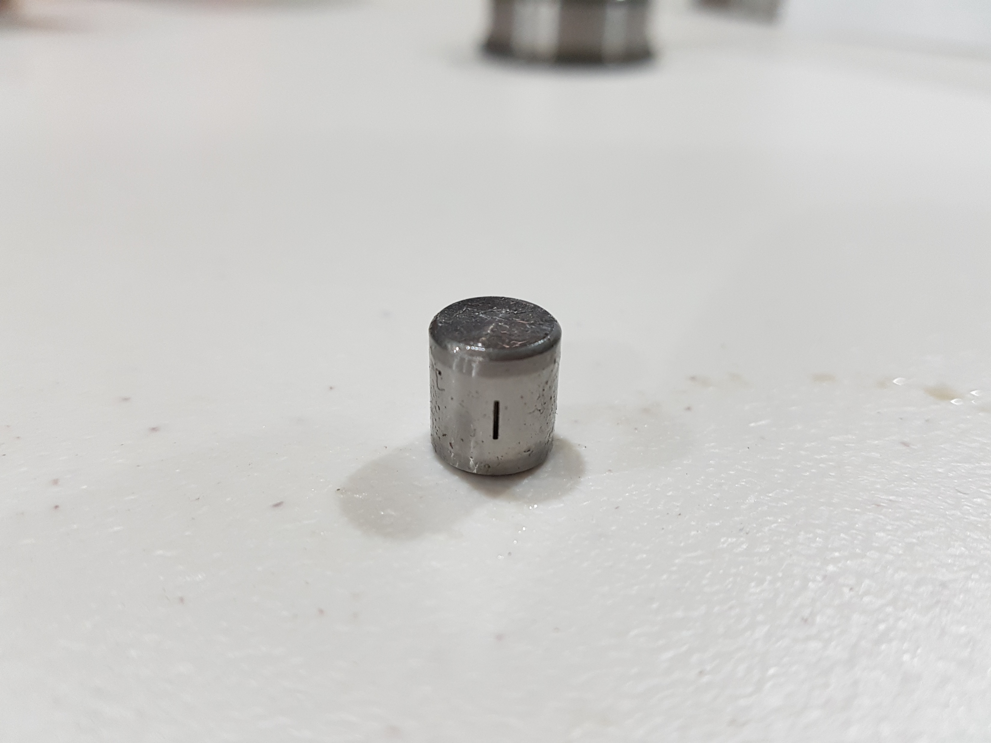
Experimental Setup and Dataset Description
Roller
Crack size
3mm x 0.3mm x 1mm
Cage
Table 2. Summary of the dataset
Bearing Condition | Data Samples | Sampling Frequency | Recording Time
Normal | 300 | 15K Hz | 300 seconds
Inner Race Fault | 300 | 15K Hz | 300 seconds
Outer Race Fault | 300 | 15K Hz | 300 seconds
Roller Fault | 300 | 15K Hz | 300 seconds
Inner race
Outer race
Outer race crack
Inner race crack
Roller crack
10

Slide 11
Results and Performance Evaluation
Table 3. Classification models results and analysis
Classifier | Training Accuracy | Test Accuracy
Random Forest | 96.59 | 98.54
Ensemble Bagged Tree | 97.56 | 98.54
Coarse Gaussian SVM | 97.07 | 96.60
Narrow NN | 96.10 | 98.06
Medium NN | 97.07 | 97.57
11

Slide 12
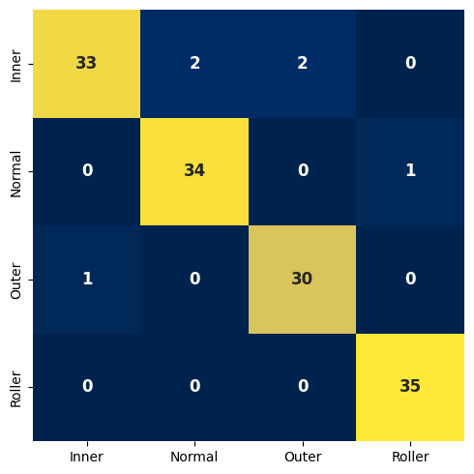
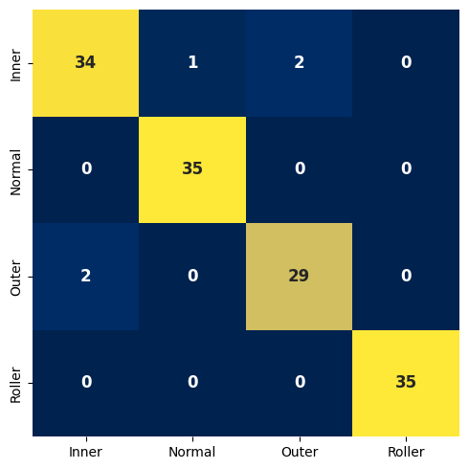
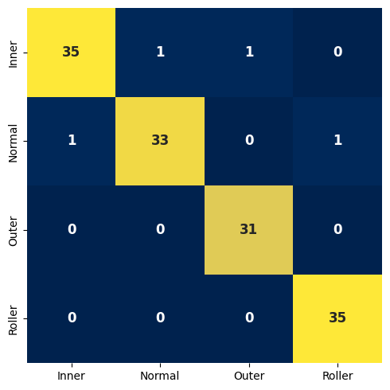
Results and Performance Evaluation
(a)
(b)
(c)
Figure 4. Confusion matrix of (a) Random Forest (b) Ensemble Bagged Tree (c) Narrow NN
12

Slide 13
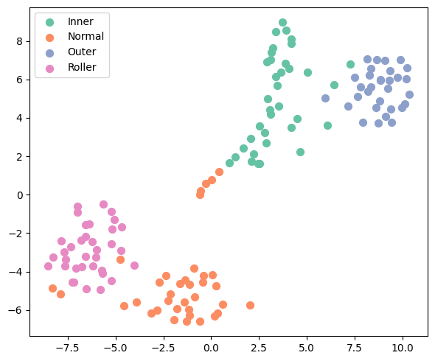


Results and Performance Evaluation
(a)
(b)
(c)
Figure 5. t-SNE plot of (a) Random Forest (b) Ensemble Bagged Tree (c) Narrow NN
13

Slide 14
Conclusions
1. This research focuses on classifying bearing conditions normal, IRF, ORF, and roller element fault using statistical time-domain features.
2. A comprehensive comparison was conducted between neural and non-neural classifiers, utilizing two feature sets: the original nine STFs and a reduced STFs set.
3. The reduced feature set consistently demonstrated higher classification accuracy across all models compared to the full STFs set.
4. The RF, Ensemble Bagged Tree, and Narrow NN classifiers achieved the best performance, delivering high classification accuracy with both feature sets.
5. Experimental validation on real-world bearing datasets demonstrates practicality and efficacy, signifying a significant advancement in bearing fault diagnosis technology.
14

Slide 15
Future Work Recommendation
Future work includes exploring advanced deep-learning methods to improve classification accuracy. Using larger and more diverse datasets will also help ensure reliable performance across different conditions. Performance comparisons with other models will demonstrate effectiveness in various scenarios.
15

Slide 16
Thank You
For queries, please get in touch with us at: faisal1999@mail.ulsan.ac.kr
16

